Slide 1


Investigate Business Hotel using Data Visualization
Created by:
Ferry Setefanus
ferrysetefanus@gmail.com
https://www.linkedin.com/in/ferry-setefanus-257098170/
Data Science enthusiast with a bachelor's degree in information systems at STMIK Pontianak. Passionate in data science, data analysis, machine learning and loves learning new things related to technology. Have experience in warehousing field for 4 years. Currently looking for an opportunity to work in the data field.

Slide 2
Overview
“It is very important for a company to always analyze its business performance. On this occasion, we will explore the business in the hospitality sector. The focus we are aiming for is to find out our customers' behavior in making hotel reservations, and its relationship to the hotel booking cancellation rate. The results of the insights we find will be presented in the form of data visualization to make it easier to understand and more persuasive. ”

Slide 3
Data Preprocessing
Handle Missing Values
There are several columns that have null values, namely company, agent, city and children. For the company, agent and children columns, the null value will be filled with 0 because some rows have NaN values that indicate unknown values, and for the city column, the null value will be filled with 'unknown'.
- Replace the 'Undefined' value in meal column to 'No Meal'
- Replace 'children', 'agent', 'company', 'days_in_waiting_list', 'required_car_parking_spaces', 'total_of_special_requests' columns data type from float64 to int64
- Drop data rows that have 0 total_guest and total_stay_duration values because it means the booking is invalid.
Replace inappropriate values
Drop unnecessary data
For more details, you can check out the jupyter notebook here.

Slide 4
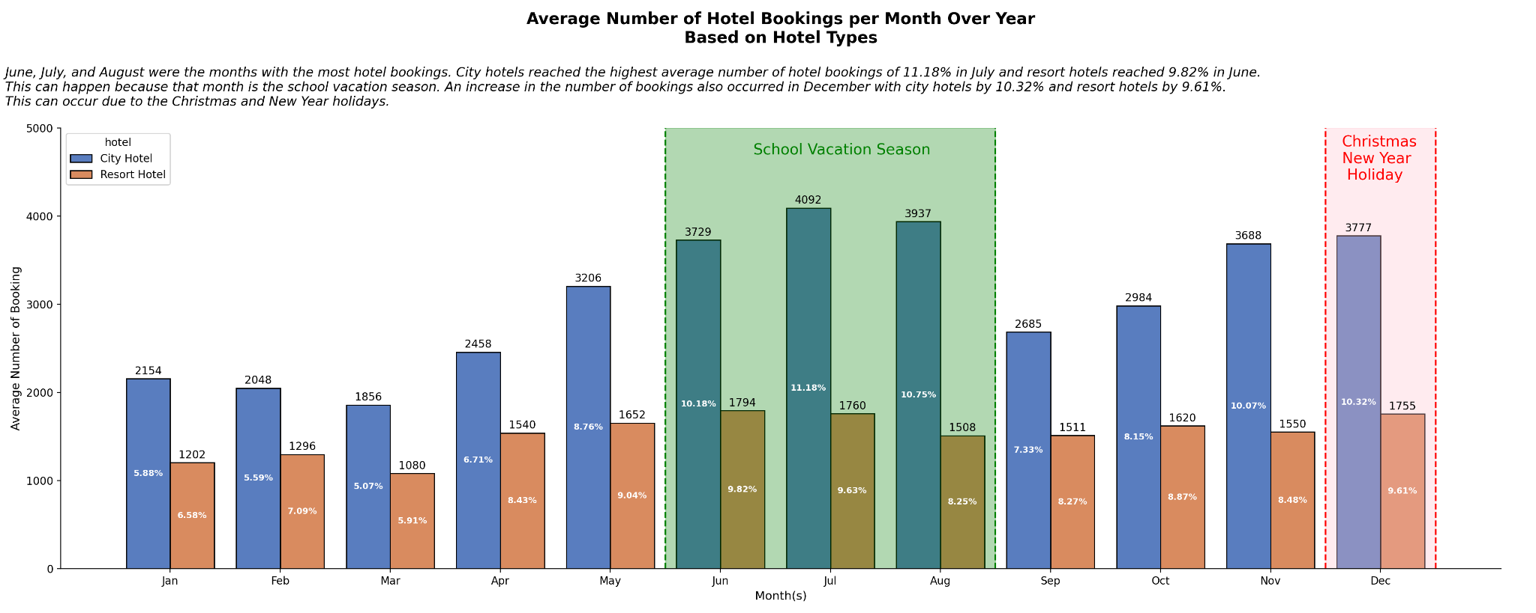
Monthly Hotel Booking Analysis Based on Hotel Type
- June, July, and August are the peak months for hotel bookings.
- These two types of hotels reached the highest bookings in July for city hotels at 11.18% (4092 bookings) and in June for resort hotels at 9.63% (1760 bookings). this can occur due to the holiday season for schools.
- An increase in hotel booking trend also occurred in December, which amounted to 10.32% (3777 bookings) for city hotels and 9.61% for hotel resorts (1755 bookings). This can occur due to the Christmas and New Year holidays.
For more details, you can check out the jupyter notebook here

Slide 5
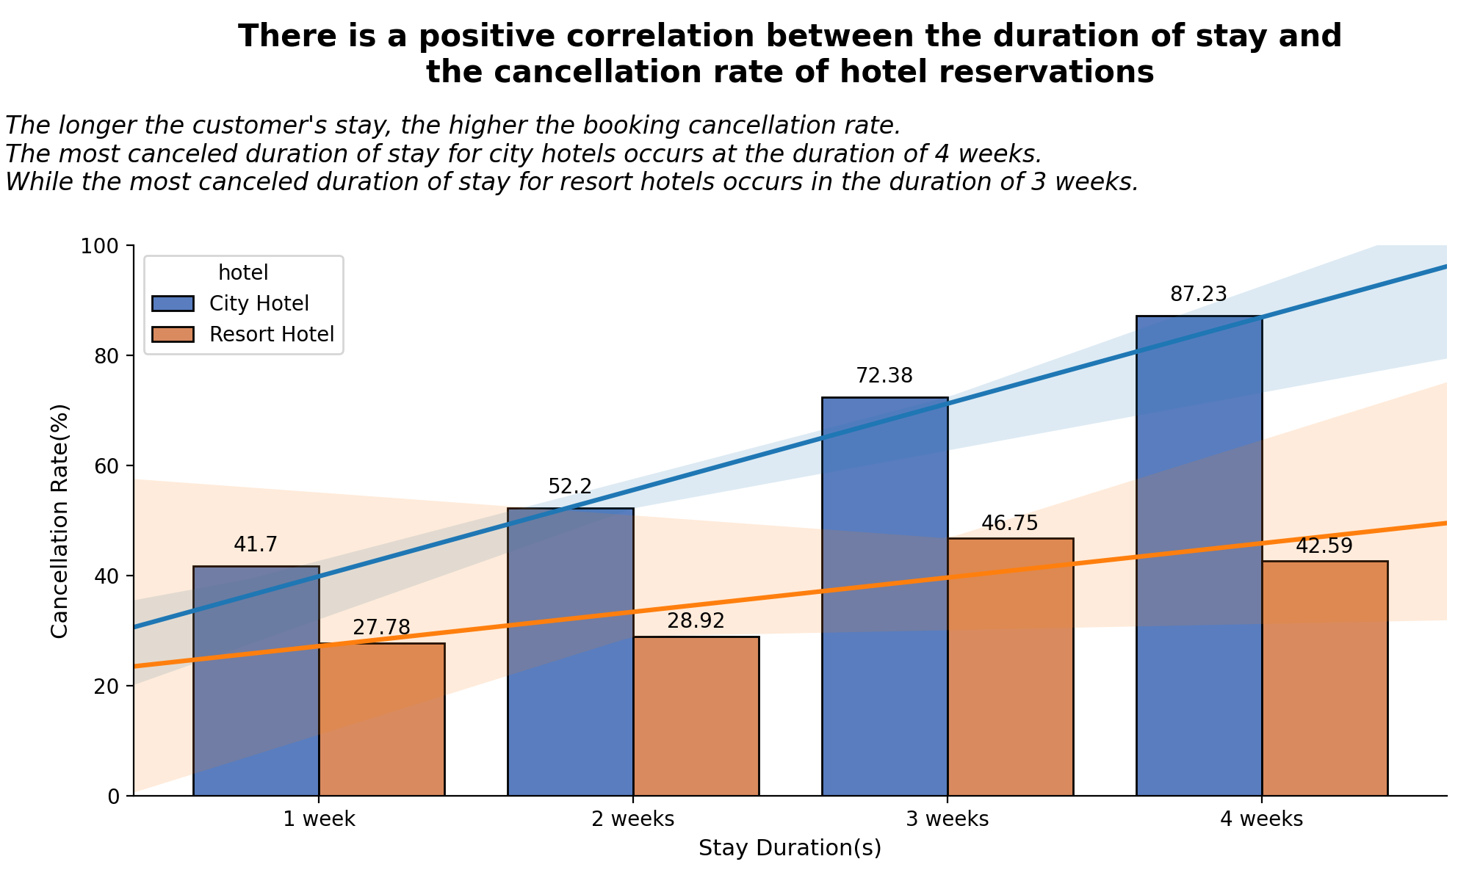
Impact Analysis of Stay Duration on Hotel Bookings Cancellation Rates
- There is a positive correlation between the booking cancellation ratio and the duration of stay for each hotel type. The longer the duration of stay, the higher the booking cancellation ratio.
- The most canceled duration of stay for city hotels occurs at the duration of 4 weeks (87.23%). While the most canceled duration of stay for resort hotels occurs in the duration of 3 weeks (46.75%).
- There are several possibilities as to why this might happen. Some examples include sudden emergencies that have to be canceled, vacation plans that have changed, or purely human errors.
For more details, you can check out the jupyter notebook here

Slide 6
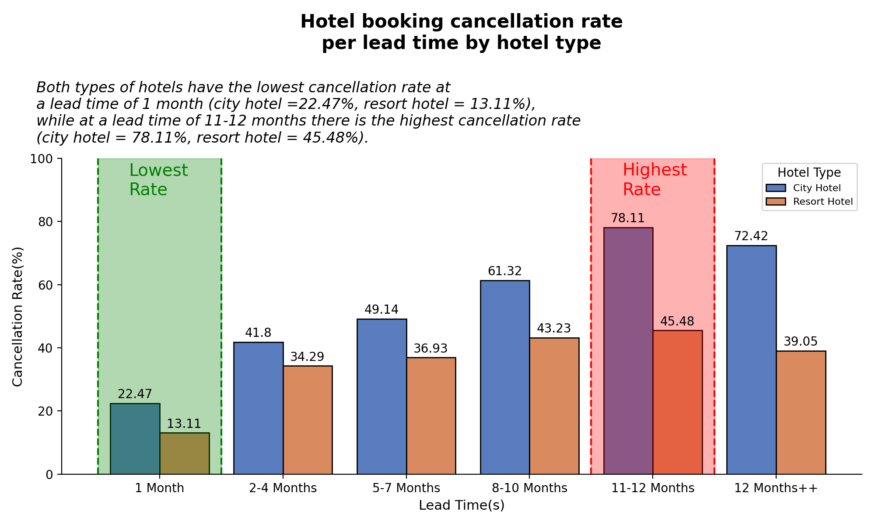
Impact Analysis of Lead Time on Hotel Bookings Cancellation Rate
- Both types of hotels have the lowest cancellation rate at a lead time of 1 month (city hotel =22.47%, resort hotel = 13.11%)
- Both types of hotel also have the highest cancellation rate at a lead time of 11-12 months (city hotel = 78.11%, resort hotel = 45.48%).
- Significant growth in cancelation rate occurs when the lead time passes 1 month.
- This growth can happen because there are initially many vacation plans that have not been thought of, but with the length of the lead time, there are more possible vacation plans that could cause the original plan to shift and have an impact on hotel bookings.
For more details, you can check out the jupyter notebook here

